Slide 1


Slide 2
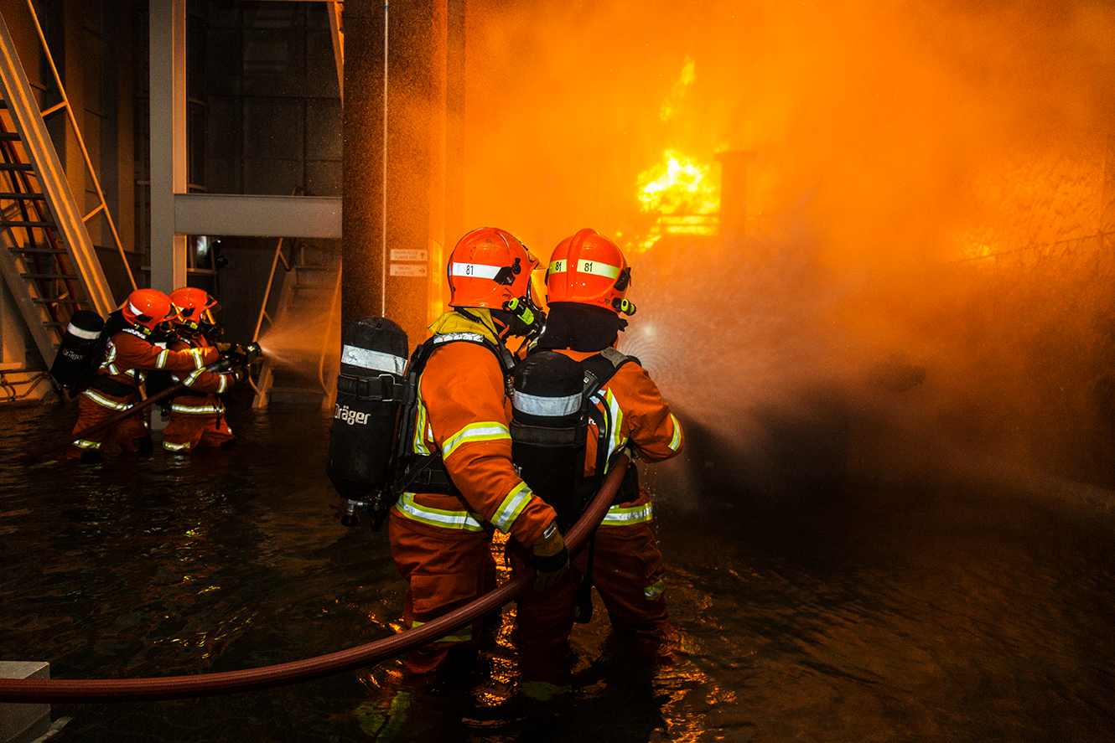

Slide 3

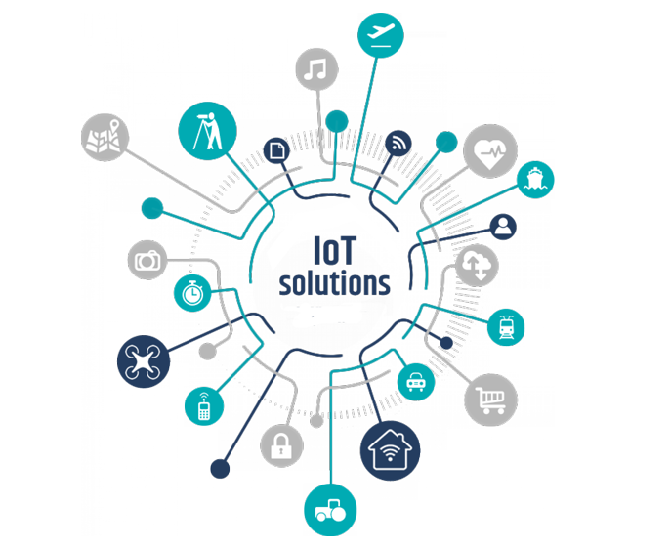
E.F.I.S

Slide 4
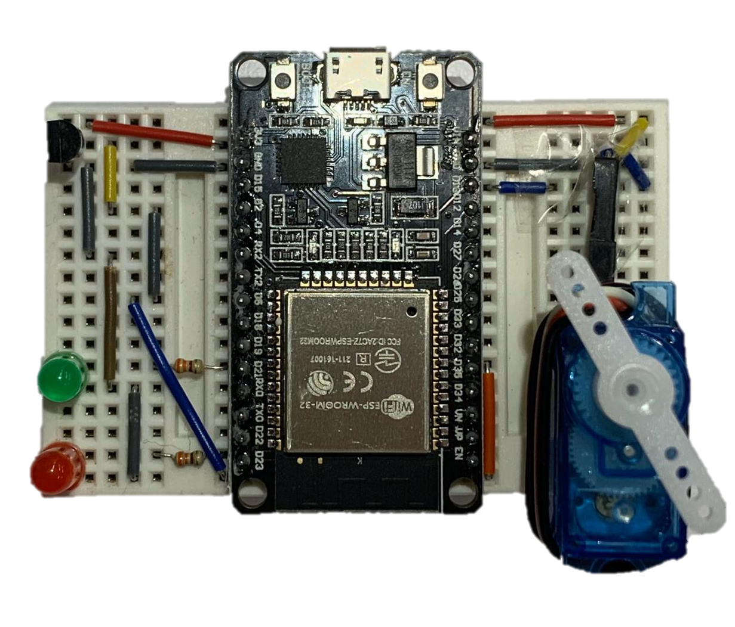
ESP32 MICROCONTROLLER

Slide 5
FIRE DETECTOR
Notes:
https://en.wikipedia.org/wiki/Fire_detection

Slide 6



DATA
STATUS
TIMESTAMP
LOCATION

Slide 7
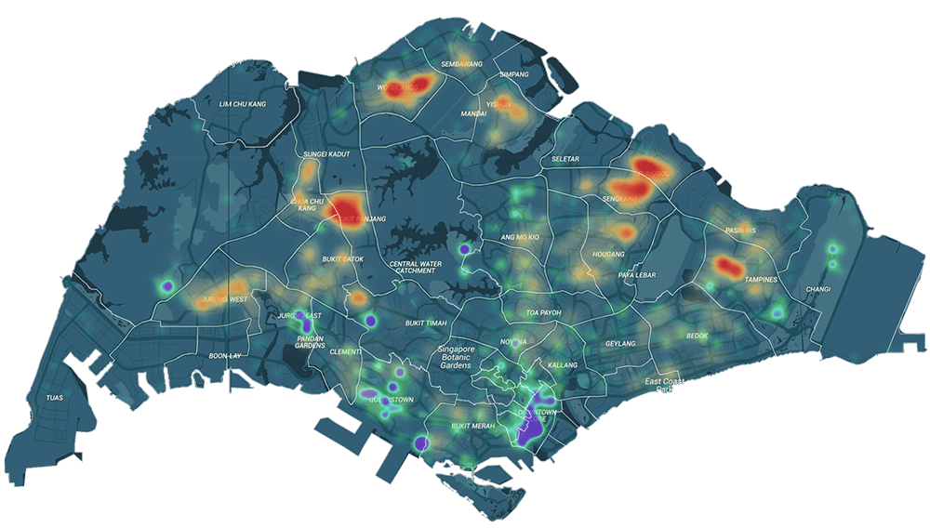
ANALYSIS

Slide 8




RUBBISH CHUTE FIRES
INTERNET OF THINGS
DATA ANALYTICS
RESOURCES OPTIMISATION
CONCLUSION

